Slide 1
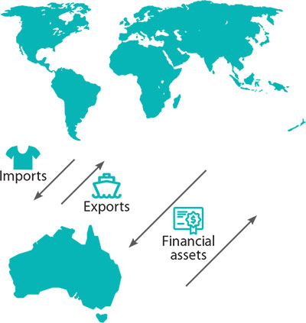
THE CONCEPT AND STRUCTURE OF THE B.O.P
SYLLABUS:
the concept and structure of Australia’s balance of payments

Slide 2
THE BALANCE OF PAYMENTS
Balance = two sides equal
Payments = money in and out

Slide 3
THE BALANCE OF PAYMENTS (B.O.P)
The Balance of Payments is a systematic record of all transactions between the residents of Australia and the residents of rest of the world.
Summary of all international economic activity
Residents = individuals, firms & the government
Think of it as when you purchase an item you get a receipt, except in this case it's a receipt of all the transactions between Australia and the world.
If you’ve ever looked at your bank account and seen money going in and out — that’s what the Balance of Payments is, but for the entire country.

Slide 4
THE BALANCE OF PAYMENTS (B.O.P)
The balance of payments is an important economic indicator for ‘open’ economies like Australia that engage in international trade because it summarises how resources flow between Australia and our trading partners.
The most common form of international transactions are for traded goods and services – imports and exports
Other transactions include income inflows (eg. Wages, dividend and interest payments).
Transfers such as foreign aid
Financial flows – (eg. foreign investment in shares and securities).

Slide 5

THE STRUCTURE OF THE B.O.P
Australia's balance of payments captures the transactions between Australian ‘residents’ and the rest of the world, over a given period (monthly/quarterly/annually).
‘Residents’ are defined broadly to include people who live in Australia, businesses that operate in Australia, the Australian government and other organisations that operate here.
In simple terms, BOP is
A monetary record of transactions INTO AND OUT OF AUSTRALIA over a period of time

Slide 6


Must Know Terminology
Debits and Credits
Money flowing into Australia are CREDITS (CR) e.g. exports out, money in
Money flowing out of Australia are DEBITS (DR) e.g. imports in, money out
Meet Chris Credit
&
Debbie Debit

Slide 7
On your whiteboards,
Payments into Australia are __________
Payments out of Australia are _________
Credit or Debit?
Investment into Australia
Purchasing a foreign car
An Australian travelling overseas
Sending pension to UK
US business man buying Australian
shares
Buying a US Government Bond
Paying for UK freight services
Foreign Aid to Indonesia
Japanese students studying in Australia
Iron Ore Export to Indonesia

Slide 8
ON YOUR WHITEBOARDS,
Payments into Australia are Credits
Payments out of Australia are Debits
Credit or Debit?
Investment into Australia C
Purchasing a foreign car D
An Australian travelling overseas D
Sending pension to UK D
US businessman buying Australian shares C
Buying a US Government Bond D
Paying for UK freight services D
Foreign Aid to Indonesia D
Japanese students studying in Australia C
Iron Ore Export to Indonesia C

Slide 9
CURRENT ACCOUNT & CAPITAL/ FINANCIAL ACCOUNT
The BOP divides transactions into two broad accounts:
Current Account
captures the net flow of money that results from Australia engaging in international trade
Combined capital and financial account
capture Australia's net change in ownership of assets and liabilities.
These broad accounts are often referred to as the ‘two sides’ of the balance of payments.

Slide 10
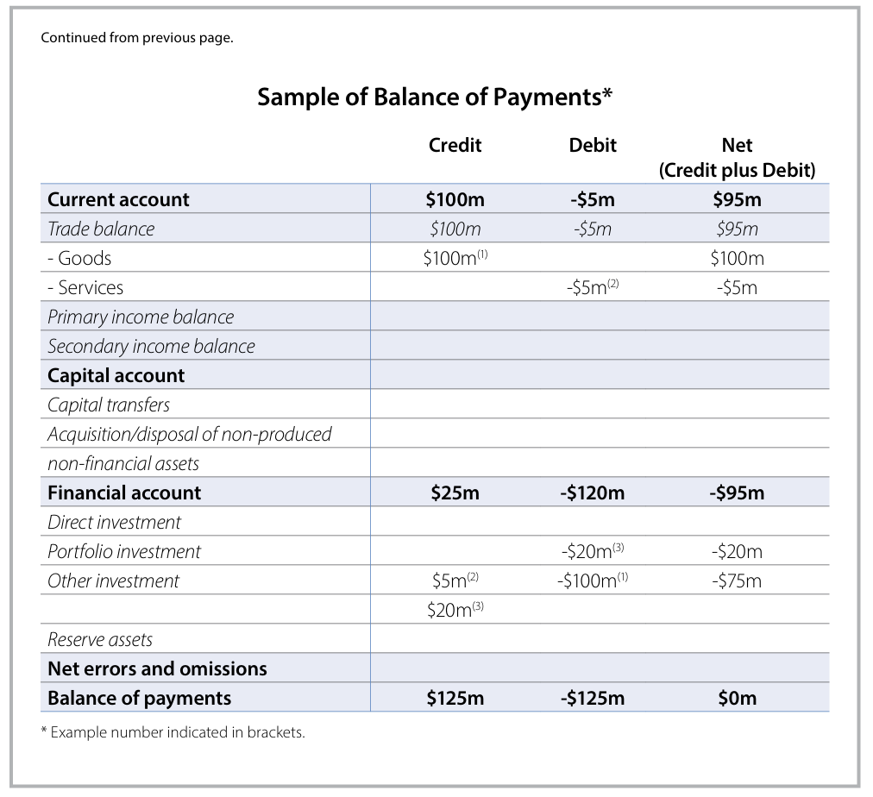

Slide 11
THE CURRENT ACCOUNT (CAB)
The current account records the value of the flow of goods, services and income between Australian residents and the rest of the world.
There are three components to the current account:
‘Trade balance’
‘Primary income balance’
‘Secondary income balance’
Most attention is usually given to the trade balance, which records the difference between the value of our exports and imports of goods and services. This is because the trade balance forms part of gross domestic product
The term ‘current’ is used in describing the current account because the goods, services and income being traded in will be consumed or received in the current period (specifically, within the quarter).

Slide 12
THE CURRENT ACCOUNT
COMPONENT | DESCRIPTION
Balance on Goods and Services (BOGS)/ Trade Balance | The value of goods and services that Australian residents export less those that they import.
Primary Income | The income that Australian residents earn from, less that they pay to, the rest of the world from working (e.g. wages) and from financial investments (e.g. dividends, interest repayments, profits)
Secondary Income (Miscellaneous earnings) | Consists of two parts: The income that Australian residents earn from, less that they pay to, the rest of the world from the government (e.g. tax payments and refunds). Current transfers: transactions between Australian residents and the rest of the world where one party provides something to be consumed by another party without receiving anything in return (e.g. emergency food aid, insurance payouts, pension payments).

Slide 13
THE CAPITAL AND FINANCIAL ACCOUNT (KAFA)
The combined capital and financial account records the capital and financial transactions between Australia and the rest of the world.
The capital account component records two main types of transactions involving capital.
‘Capital transfers’
‘Non-financial, non-produced assets’
The much larger financial account component records transactions between parties that involve a change of ownership of Australia's assets or liabilities (eg. Purchasing shares and loan principles).
It is structured according to the different classes of investment that owners of these assets or liabilities can undertake.
‘Direct investment’
‘Portfolio investment’
‘Financial derivatives’
‘Reserve assets’
‘Other investments’

Slide 14
CAPITAL AND FINANCIAL ACCOUNT (KAFA)
 | COMPONENT | DESCRIPTION
CAPITAL ACCOUNT | Capital Transfers | Transactions where one party has transferred ownership of something to another party without receiving anything specific in return. For example: forgiveness of debt (so that the borrower no longer has to pay back what they borrowed) conditional grants for capital projects (e.g. foreign aid to build roads, dams and schools) transfer of assets between residents and non-residents.
 | Acquisition/ Disposal of non-produced, non-financial assets | Transactions that involve intangible assets (e.g. brand names, copyrights and trademarks) and rights to use land or water (e.g. for mining or fishing).
FINANCIAL ACCOUNT | Direct Investment | Financial transactions related to long-term capital investment in a business (e.g. purchase of machinery, buildings and factories), where the investor has significant – 10% or more – voting power in the business (i.e. through ownership of ordinary shares or voting stock). (Non speculative)
 | Portfolio Investment | The purchase of equity or debt (shares or bonds) in a business (<10%). In contrast to direct investment, portfolio investment occurs when the investor does not have an influence in business operations. (More speculative)
 | Financial Derivatives | The purchase or sale of financial derivatives (i.e. financial contracts between two parties where the value is derived from another financial instrument, such as a bond, share, currency exchange rates, market indexes). These transactions involve the exchange of risk between parties, rather than funds.
 | Reserve Assets | The purchases or sale of reserve assets held by the Reserve Bank. These reserves are assets controlled by the Reserve Bank to meet policy objectives such as intervention in the foreign exchange market and to assist the Australian government in meeting its commitments to the IMF.
 | Other Investments | Transactions that do not fit into one of the other categories. One example is ‘trade credit’ where an importer purchases goods from overseas and does not pay for the goods until they are received. Another example is ‘currency and deposits’, where money is deposited in or withdrawn from banks across borders, or banknotes and coins are transferred between countries.

Slide 15
CLOSER LOOK AT FINANCIAL DERIVATIVES
CAPITAL AND FINANCIAL ACCOUNT (KAFA)
 | COMPONENT | DESCRIPTION
 | Financial Derivatives | The purchase or sale of financial derivatives (i.e. financial contracts between two parties where the value is derived from another financial instrument, such as a bond, share, currency exchange rates, market indexes). These transactions involve the exchange of risk between parties, rather than funds.
Financial derivatives are like bets or insurance contracts between two people (or companies) about what will happen to the price of something in the future.
You're not buying an actual asset like shares or bonds, you're trading risk. You’re saying, “I think this will go up” or “I’ll protect myself if this goes down.”
Examples:
Share prices
Interest rates
Currency exchange rates
Market indexes
Why is it in the financial account?
Because even though no physical money or goods might change hands right away, these transactions involve financial value and risk, and they connect Australia to the rest of the world.
Notes:
An Australian bank makes a deal with a US bank: “If the Australian dollar falls, you pay me. If it rises, I pay you.”
This is a derivative contract. They’re not swapping money now, but they’re taking on risk based on currency movement.

Slide 16
Is it a non-reversible earning?
If Yes,
Current A/C (CAB)
Is it related to X/M?
If yes,
BOGS
If No, Is it a R.O.I.?
If No,
KAFA
Is it a financial asset?
If Yes, for e.g. Dividends /wages. NPY
If no, misc. Y, NSY
If yes, FA
If no, (e.g. intellectual property), Capital A/C (KA)
DI > 10% , control, LT
Portfolio: <10%, ST
Derivatives
Reserve assets (RBA)
Other

Slide 17
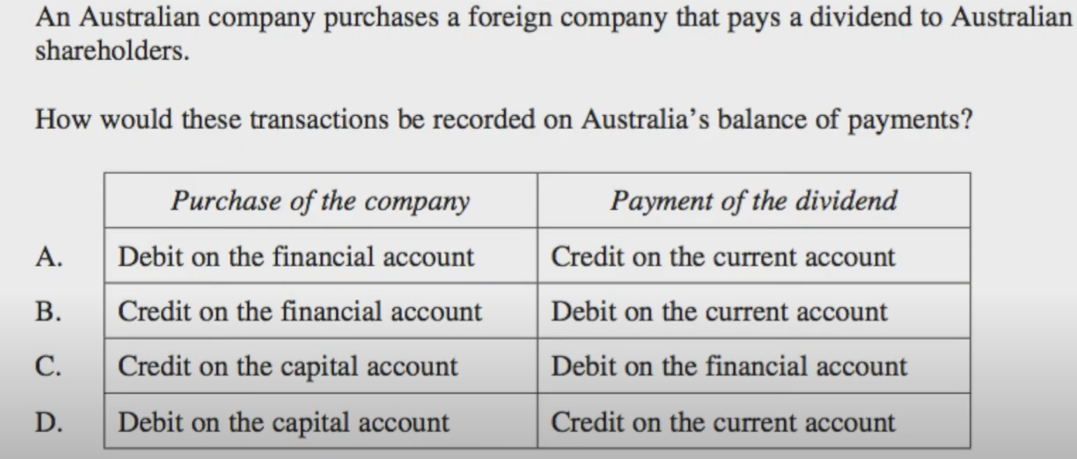
Use the chart to help sort this
Notes:
-2 transactions to sort
-First Aus purchasing a foreign company – Financial assess therefore in financial account (direct investment - controlling share)
-Debit as AUD being sent over seas
-Second transaction – share holders receive dividend – current account- primary income

Slide 18
YOUR TASK
Answer MCQ 1, 3, 6, 9, 14, and 15

Slide 19

HOMEWORK
Read the RBA Explainer – ‘The structure of the BOP’ and make dot point notes under each of the following headings about what is recorded in each account. Take note of examples and appropriate data also.
Trade balance
Net Income Balance
Current Account
Capital Account
Financial Account
Net Errors and Omissions

Slide 20
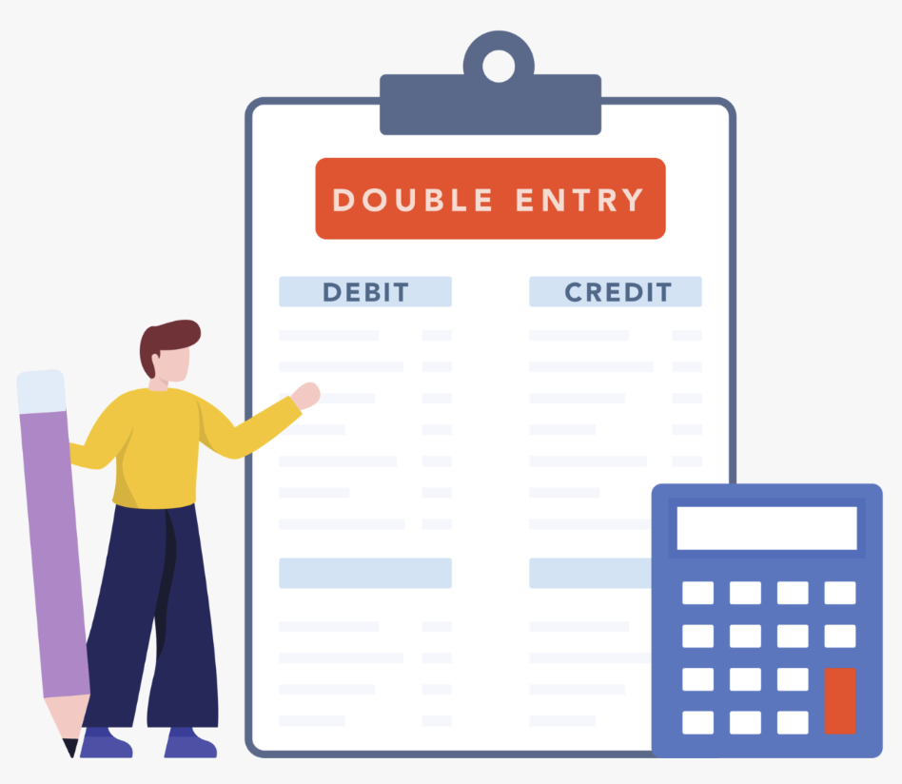
BALANCE OF PAYMENTS
SYLLABUS:
double entry system of recording transactions

Slide 21
DAILY REVIEW
Using the Current Account table (slide 12) and the KAFA slide (14)
Decide which section of the BOP these transactions belong. Also give the sub-section (EG – Primary Income) and whether it is a CR or DR.

Slide 22
DAILY REVIEW
Australian spending money in Bali
Mining company purchasing trucks
Businessman paying interest for loan, to overseas Investor
Chinese Business buying shares in Australian company
Purchasing shipping for iron ore
Coal export to China
Donation to Charity in Africa
Australian company buying shares in Facebook
Chinese company paying for Australian education
Purchasing the rights to use Nando’s name in Australia
RBA selling gold to overseas country
Drawing on funds in UK bank account for the purchase of a house in Australia
Apple iPhone shipment to Australia
Overseas company paying interest to Australian company

Slide 23
DAILY REVIEW
Australian spending money in Bali - Current Account, Services, Debit
Mining company purchasing trucks
Businessman paying interest for loan, to overseas Investor
Chinese Business buying 25% shares in Australian company
Purchasing shipping for iron ore
Coal export to China
Donation to Charity in Africa
Australian company buying 5% shares in Facebook
Chinese company paying for Australian education
Purchasing the rights to use Nando’s name in Australia
RBA selling gold to overseas country
Drawing on funds in UK bank account for the purchase of a house in Australia
Apple iPhone shipment to Australia
Overseas company paying interest to Australian company

Slide 24
DAILY REVIEW
Australian spending money in Bali Current Account, Services, Debit
Mining company purchasing trucks Current Account, Goods, Debit
Businessman paying interest for loan, to overseas Investor Current Account, Primary Income, Debit
Chinese Business buying 25% shares in Australian company Financial Account, Direct Investment, Credit
Purchasing shipping for iron ore Current Account, Services, Debit
Coal export to China Current Account, Goods, Credit
Donation to Charity in Africa Current Account, Secondary Income, Debit
Australian company buying 5% shares in Facebook Financial Account, Portfolio, Debit
Chinese company paying for Australian education Current Account, Services, Credit
Purchasing the rights to use Nando’s name in Australia Capital Account, NPNF assets, Debit
RBA selling gold to overseas country Financial Account, Reserve Assets, Credit
Drawing on funds in UK bank account for the purchase of a house in Australia Financial Account, Other, Credit
Apple iPhone shipment to Australia Current Account, Goods, Debit
Overseas company paying interest to Australian company Current Account, Primary income, Credit

Slide 25
DOUBLE ENTRY SYSTEM
In every economic transaction, something of value is given and something of equal value is received, so every transaction has two sides. This idea is captured in the double-entry accounting system used in the Balance of Payments.
Each transaction in the BoP is recorded as consisting of two equal and opposite entries reflecting the inflow and outflow element to each exchange.
For each transaction between an Australian resident and someone overseas, there is a matching credit and debit entry:
One entry records the receipt of the good or service (good, service, asset)
One entry records the payment of the receipt (transfer of currency)
**More on this later in the lesson

Slide 26
CURRENT ACCOUNT Goods Net Goods = Credits (X) – Debits (M) + Services Net Services = Credits (X) - Debits (M) |  | CAPITAL ACCOUNT Transfer of intellectual property Foreign aid used for capital Transfer of migrant funds Credits -- Debits
= Trade balance |  | = Balance on Capital Account (KA)
Income Primary Net Primary Income = Credits – Debits + Secondary Net Secondary Income = Credit - Debits _____________________________________ Net Income = Net Primary + Net Secondary ____________________________________ TB + NET INCOME = BALANCE ON CURRENT ACCOUNT |  | FINANCIAL ACCOUNT Direct Investment Portfolio Investment Other Investment Credits – Debits ________________________________ = Balance on Financial Account ________________________________ Balance on Capital Account + Balance on Financial Account = BALANCE ON THE CAPITAL & FINANCIAL ACCOUNT
SAMPLE OF BALANCE OF PAYMENTS

Slide 27
OBTAINING THE OVERALL BALANCE OF PAYMENTS
Current Account Balance (CAB) + Capital and Financial Account Balance (KAFA) = BOP
The total must always sum to 0
If the CAB is in DEFICIT then the KAFA will be in SURPLUS
If the CAB is in SURPLUS then the KAFA will be in DEFICIT
The larger the surplus, the larger the deficit.
THE BOP WILL ALWAYS BALANCE OVERALL (however, they do account for some small errors)
WHY? For every credit there is a corresponding debit. Called the double entry book-keeping system.

Slide 28

NET ERRORS AND OMISSIONS
While the Balance of Payments is meant to always equal zero (credits = debits), in reality this doesn’t always happen.
This is because:
Some transactions are hard to measure accurately
Some are completely missed or not recorded (called omitted transactions)
To fix this, there is an extra item included in the BOP called ‘Net Errors and Omissions’ is included to ensure everything balances in the end.

Slide 29
BOP IN PRACTICE
Balance of Payments $m
Current account
Goods credits 600
Goods debits 500
Net services –300
Net income ?
Capital/fin. account balance 1150
What is the current account balance?
What is the value of net income?

Slide 30
BOP IN PRACTICE
Balance of Payments $m
Current account
Goods credits 600
Goods debits 500
Net services –300
Net income ?
Capital/fin. account balance 1150
What is the current account balance?
What is the value of net income?
What is the current account balance?
Current Account Balance + Capital and Financial Account Balance = 0
∴ If Capital and Financial Account Balance = +1150, then:
Current Account Balance must be –1150
So that the accounts balance, as required by the Balance of Payments framework

Slide 31
BOP IN PRACTICE
Think of Australia like a person with two wallets:
💼 Current Account = Spending and Earning Wallet
Money In = Exports, foreign income (credits)
Money Out = Imports, paying income to foreigners (debits)
If you’re spending more than you’re earning → you have a current account deficit (net debit).
🏦 Financial Account = Borrowing and Investing Wallet
To keep your bank balance stable, you borrow money or attract investment from others
(capital inflow = credit).
That gives you a financial account surplus (net credit).
⚖️ Why They Must Balance
If Australia is spending more than it earns in trade and income (Current Account Deficit of –$1150),
then it must be borrowing or attracting investment from overseas (Financial Account Surplus of +$1150) to cover the gap.

Slide 32
BOP IN PRACTICE
Balance of Payments $m
Current account
Goods credits 600
Goods debits 500
Net services –300
Net income ?
Capital/fin. account balance 1150
What is the current account balance?
What is the value of net income?
What is the value of net income?
Step 1: Calculate Net Goods
(Goods credits – Goods debits)
Net Goods = 600 – 500 = +100

Slide 33
BOP IN PRACTICE
Balance of Payments $m
Current account
Goods credits 600
Goods debits 500
Net services –300
Net income ?
Capital/fin. account balance 1150
What is the current account balance?
What is the value of net income?
What is the value of net income?
Step 2: Current Account Balance (CAB) =
Net Goods + Net Services + Net Income
= 100 + (–300) + Net Income = –200 + Net Income

Slide 34
BOP IN PRACTICE
Balance of Payments $m
Current account
Goods credits 600
Goods debits 500
Net services –300
Net income ?
Capital/fin. account balance 1150
What is the current account balance?
What is the value of net income?
What is the value of net income?
Step 3: Use the Balance of Payments identity: Current Account + Capital/Financial Account = 0
∴ –200 + Net Income + 1150 = 0
∴ Net Income = –950

Slide 35
BOP IN PRACTICE
Balance of Payments $m
Current account
Goods credits 600
Goods debits 500
Net services –300
Net income ?
Capital/fin. account balance 1150
What is the current account balance? -1150
What is the value of net income? -950

Slide 36


Remember from earlier** The BOP balances thanks to double entry book-keeping. This means, for every transaction there is a matching offsetting entry. i.e - two entries for each transaction – money and currency
CAB
KAFA
- Value of the transaction of G/S
The offsetting entry (movement of currency transaction) is always in the FA.
KAFA
-Value of the financial asset

Slide 37
CREDITS & DEBITS IN THE KAFA
In Balance of Payments (BOP) accounting, credits and debits don't just mean money coming in or going out like in a bank statement. Instead, they reflect changes in ownership of assets and liabilities between residents and non-residents.
Because the Current Account (CAB) records trade in goods and services (exports and imports), credits and debits there reflect actual inflows and outflows of goods and services.
The Capital and Financial Account (KAFA) records changes in ownership of financial assets or liabilities. In the KAFA credits represent increases in Australia’s liabilities or decreases in its assets abroad, while debits represent increases in assets or decreases in liabilities.
Notes:
The idea that credits = increases in liabilities or decreases in assets, and debits = increases in assets or decreases in liabilities is true for the KAFA.
In the Current Account, credits and debits represent exports and imports of goods and services, not asset ownership changes.

Slide 38
CREDITS IN THE KAFA
Credit (+ve) = A transaction that increases Australia’s liabilities to the rest of the world or reduces Australia’s assets
Australia takes on more liabilities (owes more to foreigners) → e.g. borrowing money from overseas
OR Australia gives up/reduces its assets → e.g. sells foreign shares, withdraws money from a foreign bank account, or money leaves an Australian resident’s bank account to pay overseas
A decrease in assets happens when Australians give up ownership of something they previously owned, which is considered as supplying financial assets to the rest of the world and that’s why it’s recorded as a credit in the KAFA

Slide 39
DEBITS IN THE KAFA
Debit (–ve) = A transaction that increases Australia’s assets abroad or reduces Australia’s liabilities
Australia increases its ownership of financial assets overseas → e.g. buys foreign shares, invests in property overseas, deposits money in a foreign bank account
OR Australia pays off or reduces its liabilities to the rest of the world → e.g. repays a loan to a foreign lender
An increase in assets happens when Australians purchase or build up financial claims overseas, which is considered as acquiring financial assets from the rest of the world — and that’s why it’s recorded as a debit in the KAFA.

Slide 40
CREDITS & DEBITS IN THE KAFA
Credit = A transaction that increases Australia's liabilities to the rest of the world or decreases Australia's assets
Debit = A transaction that increases Australia's assets abroad or decreases Australia's liabilities.
Transaction | What changes? | KAFA Entry
Australians buy foreign shares (increasing assets abroad) | Australia gains a financial asset | Debit
Australians send money overseas to pay for imports (reducing assets) | Australia loses a financial asset | Credit
Notes:
The idea that credits = increases in liabilities or decreases in assets, and debits = increases in assets or decreases in liabilities is true for the KAFA.
In the Current Account, credits and debits represent exports and imports of goods and services, not asset ownership changes.

Slide 41
DOUBLE ENTRY SYSTEM
Export transactions - Two entries
Entry 1 - A credit entry (+ve) is recorded when a transaction gives rise to a receipt by a domestic resident to a foreign resident. This occurs when Australia provides something of value (like exports or receiving income from overseas for education or tourism).
Entry 2 - A matching debit entry (-ve) is recorded for the actual payment of this receipt, which shows how the foreign buyer transfers the money (eg. transfer of foreign currency to an Australian bank account).
One entry shows what we sold and one entry shows how we got paid.

Slide 42
DOUBLE ENTRY SYSTEM
Import transactions - Two entries
Entry 1 – A debit entry (–ve) is recorded when Australia receives something of value from overseas, such as imported goods or services (Australian student studying or travelling overseas).
Entry 2 – A matching credit entry (+ve) is recorded for the payment of this transaction, which shows how the Australian buyer transfers money overseas (e.g. transfer of Australian dollars to a foreign bank account).
One entry shows what we bought, and one entry shows how we paid for it.

Slide 43
EXAMPLE: SHIPMENT OF $2 MILLION WHEAT EXPORTED FROM AUSTRALIA TO AN OVERSEAS BUYER
Credit Entry Australia exports $2 million worth of wheat. → This is a credit in the Current Account (specifically under goods exports) because Australia is providing something of value to the rest of the world.
2. Debit Entry The overseas buyer pays the Australian exporter in AUD (Australia receives money). → This is a debit in the Financial Account. Why?
The overseas buyer needs to obtain Australian dollars.
They might:
Use AUD they already hold (in reserves or Australian bank accounts), or
Exchange their own currency for AUD on the foreign exchange market.

Slide 44
EXAMPLE: SHIPMENT OF $2 MILLION WHEAT EXPORTED FROM AUSTRALIA TO AN OVERSEAS BUYER
Either way, this results in an inflow of AUD and an outflow of foreign currency into Australia's financial system — this is recorded as a debit (negative entry) in the Financial Account, because it reflects either:
An increase in Australia’s foreign assets (e.g. more foreign currency held), or
A decrease in Australia’s foreign liabilities (less AUD owed to foreigners).
Summary
Credit: $2 million in wheat exports (Current Account)
Debit: $2 million offset in Financial Account (foreign exchange/payment)
Because every transaction has two equal and opposite entries, the balance of payments stays in balance (net = 0).
Notes:
The export of wheat from Australia is recorded as a credit entry in the Current Account, under the category “Exports of Goods.” This credit reflects money flowing into Australia - Australia has earned foreign income by selling goods overseas.
But every transaction in the Balance of Payments must also have a matching debit entry.
That debit is not recorded in the current account. Instead, it typically appears in the Financial Account.
Here’s why: To pay for the wheat, the overseas buyer needs to obtain Australian dollars (AUD). To do this, they might:
Use AUD they already hold, or
Buy AUD on the foreign exchange market by exchanging their own currency.
In either case, this results in a debit entry in the Financial Account - possibly under categories like:
Increase in foreign assets, or
Capital outflow.
This reflects that while Australia is receiving AUD, it is also giving up foreign currency or gaining claims on foreign financial assets.

Slide 45
EXAMPLE: AN AUSTRALIAN FARMER EXPORTS $100 MILLION OF WOOL TO A CLOTHING MANUFACTURER IN INDIA.
Question | Answer
What are the two offsetting items? (hint: one of them is often money!)
Which accounts does each transaction belong in?
Which item is being provided by Australia and which is being received by Australia?

Slide 46
EXAMPLE: AN AUSTRALIAN FARMER EXPORTS $100 MILLION OF WOOL TO A CLOTHING MANUFACTURER IN INDIA.
Question | Answer
What are the two offsetting items? (hint: one of them is often money!) | Wool Money
Which accounts does each transaction belong in? | BOGS (current account) Other investment (financial account)
Which item is being provided by Australia and which is being received by Australia? | Wool provided by Australia (credit) Money received by Australia (debit)

Slide 47
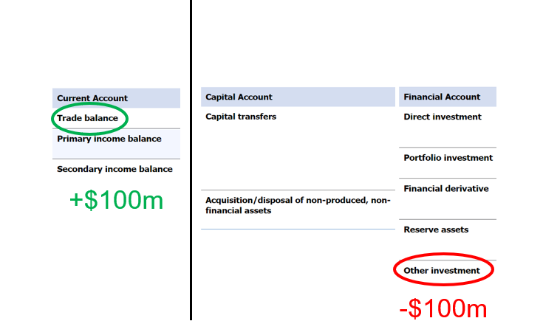

Slide 48
EXAMPLE: AN AUSTRALIAN BUYS $2,000 AUD OF SHARES IN A FRENCH COMPANY
Question | Answer
What are the two offsetting items? (hint: one of them is often money!)
Which accounts does each transaction belong in?
Which item is being provided by Australia and which is being received by Australia?

Slide 49
EXAMPLE: AN AUSTRALIAN BUYS $2,000 AUD OF SHARES IN A FRENCH COMPANY
Question | Answer
What are the two offsetting items? (hint: one of them is often money!) | French company shares Money
Which accounts does each transaction belong in? | Portfolio investment (financial account) Other investment (financial account)
Which item is being provided by Australia and which is being received by Australia? | Shares received by Australia (debit) Money Provided by Australia (credit)

Slide 50
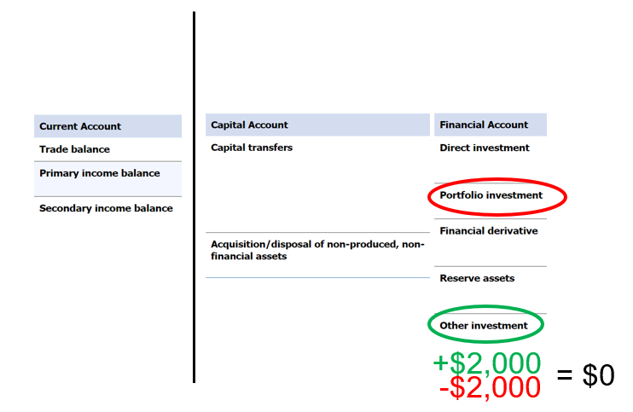

Slide 51
CREDIT AND DEBIT SCENARIOS TRAVEL EDITION
Australian residents, including friends Michelle and Megan, go on overseas holidays to Bali during winter and spend a total of $5000. The Australian residents pay for their holiday by using money deposited in their Australian bank accounts.
The $5000 Australian residents spent on overseas travel is an import and is recorded as a ‘service debit’ in the trade balance (specifically ‘import – tourism’).
The payments made to overseas households and businesses (for the accommodation, food, sightseeing, etc.) by the Australian residents from their domestic bank accounts are recorded in the financial accounts as a credit under ‘other investment – currency and deposits’.
Notes:
The $5000Australian residents spent on overseas travel is an import and is recorded as a ‘service debit’ in the trade balance (specifically ‘import – tourism’). The payments made to overseas households and businesses (for the accommodation, food, sightseeing, etc.) by the Australian residents from their domestic bank accounts are recorded in the financial accounts as a credit under ‘other investment – currency and deposits’.

Slide 52
CREDIT AND DEBIT SCENARIOS TRAVEL EDITION
If the $5000 is paid from Australian bank accounts to overseas businesses (like hotels or tour companies in Bali), it means money is leaving Australia. That’s seen as a reduction in Australia’s financial assets — because Australians now have $5000 less in their bank accounts.
This is recorded as a credit in the financial account, under ‘other investment – currency and deposits’, because money (a financial asset) has flowed out of Australia to pay for the services.
In the Current Account Balance (CAB), the $5000 for overseas holidays is a debit (import of services).
In the Capital and Financial Account (KAFA), the matching entry is a credit (money leaving the country = reduction in financial assets).
This double entry — one in the current account, one in the financial account — is the foundation of Balance of Payments accounting.
Notes:
The $5000Australian residents spent on overseas travel is an import and is recorded as a ‘service debit’ in the trade balance (specifically ‘import – tourism’). The payments made to overseas households and businesses (for the accommodation, food, sightseeing, etc.) by the Australian residents from their domestic bank accounts are recorded in the financial accounts as a credit under ‘other investment – currency and deposits’.

Slide 53
CREDIT AND DEBIT SCENARIOS
An Australian mining company exports $100 million of iron ore to a private Chinese steel maker. The Chinese steel maker will only provide payment for the shipment once it arrives in China from Australia (which is known as a trade credit because payment is only made after the goods are received).
The $100m shipment of iron ore from Australia is an export and is recorded as a ‘goods credit’ under the trade balance.
The trade credit payment from the Chinese steel maker is recorded in the financial accounts as a debit under ‘other investment – trade credit’.
Notes:
The $100m shipment of iron ore from Australia is an export and is recorded as a ‘goods credit’ under the trade balance.
The trade credit payment from the Chinese steel maker is recorded in the financial accounts as a debit under ‘other investment – trade credit’.

Slide 54
CREDIT AND DEBIT SCENARIOS
Taylor, an Australian resident, buys $20 million of shares in a company listed on the New York Stock Exchange, equivalent to less than 10 per cent of the voting rights in that company. The shares are paid for using money from Taylor’s bank account in Australia.
Notes:
The $20 million of shares purchased by Taylor is recorded in the financial account as a debit under ‘portfolio investment’, because the purchase does not result in a significant degree of influence over the firm. The payment for the shares is made from Taylor's Australian bank account and recorded in the financial accounts as a credit under ‘other investment – currency and deposits’.

Slide 55
CREDIT AND DEBIT SCENARIOS
Taylor, an Australian resident, buys $20 million of shares in a company listed on the New York Stock Exchange, equivalent to less than 10 per cent of the voting rights in that company. The shares are paid for using money from Taylor’s bank account in Australia.
The $20 million of shares purchased by Taylor is recorded in the financial account as a debit under ‘portfolio investment’, because the purchase does not result in a significant degree of influence over the firm.
The payment for the shares is made from Taylor's Australian bank account and recorded in the financial accounts as a credit under ‘other investment – currency and deposits’.
Notes:
The $20 million of shares purchased by Taylor is recorded in the financial account as a debit under ‘portfolio investment’, because the purchase does not result in a significant degree of influence over the firm. The payment for the shares is made from Taylor's Australian bank account and recorded in the financial accounts as a credit under ‘other investment – currency and deposits’.

Slide 56
CREDIT AND DEBIT SCENARIOS
Taylor, an Australian resident, buys $20 million of shares in a company listed on the New York Stock Exchange, equivalent to less than 10 per cent of the voting rights in that company. The shares are paid for using money from Taylor’s bank account in Australia.
The payment for the shares is made from Taylor's Australian bank account and recorded in the financial accounts as a credit under ‘other investment – currency and deposits’.
NOTE: This is both a credit and debit in the KAFA
Notes:
The $20 million of shares purchased by Taylor is recorded in the financial account as a debit under ‘portfolio investment’, because the purchase does not result in a significant degree of influence over the firm. The payment for the shares is made from Taylor's Australian bank account and recorded in the financial accounts as a credit under ‘other investment – currency and deposits’.

Slide 57
DRAW BOP TABLE IN YOUR BOOKS
 | CREDIT | DEBIT | TOTALS
Current Account
Capital and Financial Account
TOTALS

Slide 58
Sale of $5000 iron to China
CR of $5000 in CA (goods) and offsetting entry is DR of $5000 in FA representing the import of currency.
Sale of $2000 shares to US investor
CR of $2000 in FA and offsetting entry is DR of $2000 in FA representing the import of currency.
Purchase of $10,000 worth of TVs from Korea
DR of $10,000 in CA (goods) and offsetting entry is CR of $10,000 in FA representing the export of currency

Slide 59
SOLUTION
 | CREDIT | DEBIT | TOTALS
Current Account | +$5000 (Iron Ore) | -$10,000 (TV’s) | +$5,000
Capital and Financial Account | +$2000 (Shares) +$10,000 (Currency) | -$2000 (Currency) -$5000 (Currency) | -$5,000
TOTALS | +$17,000 | -$17,000 | $0

Slide 60
YOUR TURN
Record the following transactions. Work out which account the transaction is first recorded in. The offsetting transaction then goes in the FA.
Sale of an Australian farm worth $25k to a Chinese Investor
Australian tourists spend $15k overseas
Australia sells $50k worth of LNG to Korea
Australia purchases Indian Telecomms businesses for $80k

Slide 61
YOUR TURN
 | CREDIT | DEBIT | TOTALS
Current Account
Capital and Financial Account
TOTALS

Slide 62
YOUR TURN SOLUTIONS
 | CREDIT | DEBIT | TOTALS
Current Account | +$50,000 (LNG) | -$15,000 (Australian tourists) | +$35,000
Capital and Financial Account | +$25,000 (Farm) +$15,000 (Currency) +$80,000 (Currency) | -$25,000 (Currency) -$50,000 (Currency) -$80,000 (Indian business) | -$35,000
TOTALS | +$170,000 | -$170,000 | $0

Slide 63
INDEPENDENT PRACTICE
Try the review on page 59 of your textbook
And on page 66 of your textbook

Slide 64
DAILY REVIEW
Classify the following according to how they would be recorded on the BoP double entry system.
A Malaysian tourist visits the new museum
Ailsa, an Australian resident, goes on holiday to the UK.
A local noodle cafe sources its ingredients from Indonesia.
An Australian backpacker earns money by working in London.
An American shareholder in an Australian company, Wesfarmers, receives a $450 dividend payment
The local Scouts send money they have to aid Vanuatu in recovering from the latest Cyclone.
Notes:
The local Scouts send money they have to aid Vanuatu in recovering from the latest Cyclone.

Slide 65
DAILY REVIEW
Classify the following according to how they would be recorded on the BoP double entry system.
A Malaysian tourist visits the new museum – CAB – Services, Credit & Financial Account - Other investment, Debit
Ailsa, an Australian resident, goes on holiday to the UK - Current Account – Services, Debit & Financial Account – Other investments, Credit
A local noodle cafe sources its ingredients from Indonesia. Current Account – Goods (Import of goods), Debit & Financial Account – Other investments, Credit
An Australian backpacker earns money by working in London. CAB – Primary income, Credit & Financial Account - Other investment, Debit
An American shareholder in an Australian company, Wesfarmers, receives a $450 dividend payment. CAB – Primary income, Debit & Financial Account – Other investments, Credit
The local Scouts send money they have to aid Vanuatu in recovering from the latest Cyclone. Current Account, Secondary Income, Debit & Financial Account – Other investments, Credit

Slide 66
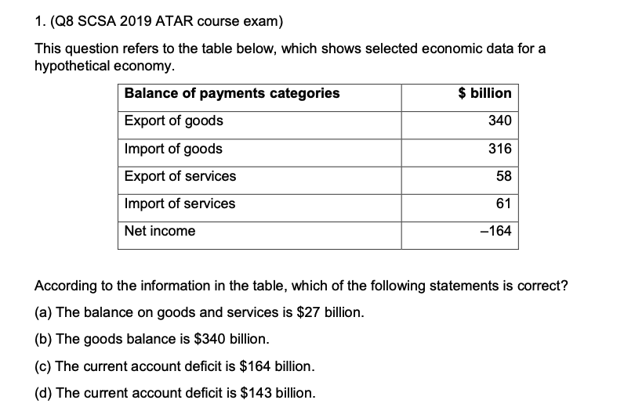

Slide 68
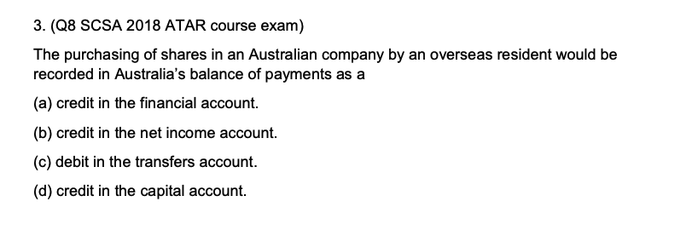

Slide 70
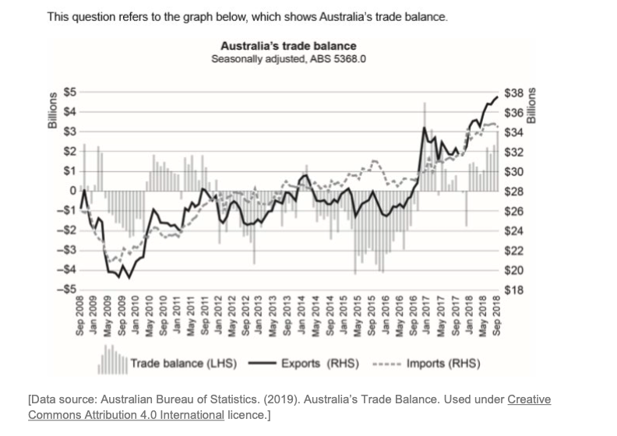
Identify the year that had the largest monthly trade deficit.
Identify the value of the trade balance in September 2018.
Identify the value of Australian exports in September 2015.

Slide 71
Identify the year that had the largest monthly trade deficit. 2015
Identify the value of the trade balance in September 2018. $3 billion
Identify the value of Australian exports in September 2015.
Answers between:
$27–$28.1 billion

Slide 72
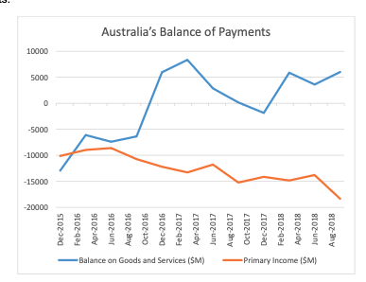
Identify the year that had the largest monthly trade surplus
What was the value of the trade balance in December 2017?

Slide 73
Identify the year that had the largest monthly trade surplus
What was the value of the trade balance in December 2017?

Slide 74
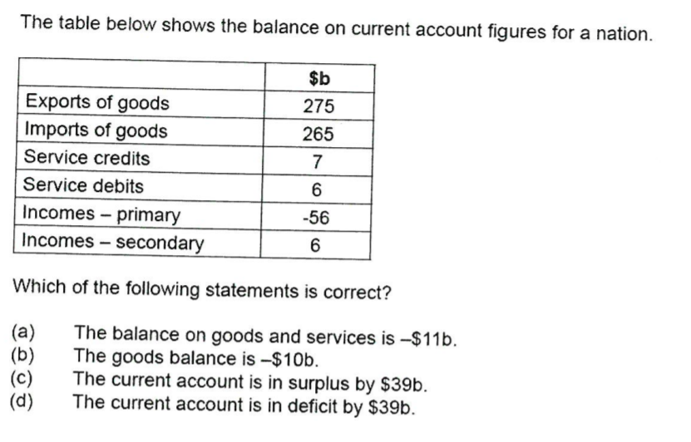

Slide 76

FACTORS INFLUENCING THE TRADE BALANCE
SYLLABUS:
the reasons for Australia’s current account balance

Slide 77
AUSTRALIA’S BOP AN OVERVIEW
BOGS – Mostly negative
NPY - Always deficit
CAB – 44 years of CAD (Current Account Deficit), changed to a CAS (Current Account Surplus) in 2019, back to CAD Sept 2023
KAFA - Surplus of 44 years, changed to a deficit in 2019, back to surplus Sept 2023
Notes:
While Australia has been exporting more goods and services than it imports since September 2019, money has flowed out of Australia in exchange for increased ownership of foreign assets, including Australian superannuation funds' purchasing of overseas equities.

Slide 78
WHAT DOES CURRENT ACCOUNT SURPLUS/DEFICIT MEAN?
A surplus (CAS) is indicative of an economy that is a net creditor to the rest of the world. This means the country is likely providing an abundance of resources to other countries’ economies and is owed money in return.
A current account balance deficit reflects a government and an economy that is a net debtor to the rest of the world. It is investing more than it is saving and is using resources from other economies to meet its domestic consumption and investment requirements.
A deficit is not necessarily bad for an economy, especially for an economy in the developing stages or under reform. Sometimes an economy must spend money now to make money in the future, so it runs a deficit intentionally.

Slide 79
Movements in the exchange rate
A lower AUD makes Aus X cheaper, so Aus will sell more X
Lower AUD also means M are more expensive, so Aus will buy fewer M
This increases BOGS
Terms of trade
Generally, a higher TOT means Aus is receiving higher X prices than the prices it pays for M
This increases X revenue and increases BOGS
Domestic economic growth
Higher domestic economic growth results in higher consumer income
Leads to increased consumption spending on M purchases
This decreases BOGS
FACTORS INFLUENCING BOGS AND AFFECTING CAB
Notes:
DEFINE TERMS OF TRADE slide

Slide 80
FACTORS INFLUENCING BOGS AND AFFECTING CAB
Narrow X base
Aus’ X are mainly primary commodities
Aus’ M are mainly expensive, high value manufactured goods (consumer and capital goods)
As a result, M payments (debit) are often greater than X revenues (credit)
This decreases the BOGS, which can decrease the CAB
Lack of international competitiveness
This is the ability of a country’s X to compete in global markets
Australia's commodity X can compete well, but they do not always command high prices
Australia lacks international competitiveness in producing manufactured goods as we cannot make them at low prices like nations such as China
This decreases the BOGS, which can decrease the CAB
Volatile commodity X
Australia’s commodity X suffer from large fluctuations in prices
During resource booms prices rise, but when growth slows, prices fall
This means that X revenues are volatile and often fall below M payments, decreasing BOGS

Slide 81

MAJOR TRADING PARTNER GROWTH
If trading partner’s growth increases (e.g. China):
Australian exports will increase, particularly in minerals and fuels and services.
This increases credits in the BOGS/Trade Balance (TB), increasing the trade balance and increasing the Current Account Balance (CAB).
If trading partner’s growth decreases:
Australian exports will fall.
This decreases credits in the BOGS/Trade Balance (TB), decreasing the trade balance and decreasing the Current Account Balance (CAB).

Slide 82

DOMESTIC GROWTH
If Australia’s growth increases:
National income rises and households will increase consumption spending, particularly on discretionary and luxury goods and services.
This will increase consumption imports.
Business will experience an increase in production and output, therefore will increase their imports of capital and intermediate goods.
This increase in consumption and capital imports will increase debits in the BOGS, decreasing the BOGS and the CAB.
If Australia’s growth decreases:
Unemployment will rise and national income falls.
Households will decrease consumption spending, particularly on discretionary items, due to a fall in income.
This will decrease consumption imports.
Businesses will experience a fall in production and output and will decrease their imports of capital and intermediate goods.
This decrease in consumption and capital imports will decrease debits in the BOGS, increasing the BOGS and the CAB.

Slide 83

EXCHANGE RATE CHANGE
If the AUD depreciates, imports become more expensive for domestic residents and exports become cheaper for overseas buyers. Assuming the demand for X and M are price elastic, exports will increase and and imports will decrease, resulting in a rise in credits and a fall in debits, increasing the BOGS and the CAB.
If the AUD appreciates, imports become cheaper for domestic residents and exports become more expensive for overseas buyers. Assuming the demand for X and M are price elastic, exports will decrease and and imports will increase, resulting in a fall in credits and a rise in debits, decreasing the BOGS and the CAB.

Slide 84
TERMS OF TRADE
The TOT measures the relative price movements in X’s and M’s.
If commodity prices increase, Australia’s export prices rise relative to import prices and thus the export price index and the TOT increase. As foreign residents are paying more for Australian exports, this will lead to an increase in credits, and therefore a rise in the BOGS and the CAB.
If the TOT falls (for example due to a fall in export prices of a rise in import prices), Australia’s export prices fall relative to import prices. This leads to a fall in credit entries relative to debit entries, which decrease the BOGS and the CAB.

Slide 85

AUSTRALIA’S LEVEL OF COMPETITIVENESS
Referring to relative wage rates, inflation rate differential, exchange rate fluctuations
If Australia’s international competitiveness increases, exports are more attractive to overseas buyers. This increases exports which increases credits in the BOGS, increasing the CAB.
If Australia’s international competitiveness falls, exports are less attractive to overseas buyers. This decreases exports which decreases credits in the BOGS, decreasing the CAB.

Slide 86

EXTERNAL SHOCKS
Changes in commodity prices or unprecedented global events
The COVID Pandemic resulted in the closure of Australia’s international border and domestic lockdown restrictions within the states.
This larges decrease in inbound travel resulted in a significant decrease of Australia’s education and tourism service exports. Personal Travel exports also decreased, however the minerals and fuels and agricultural exports remained strong.
The pandemic caused a fall in both X and M, however M fell by more in 2020 which caused an increase in the BOGS and the CAB.

Slide 87
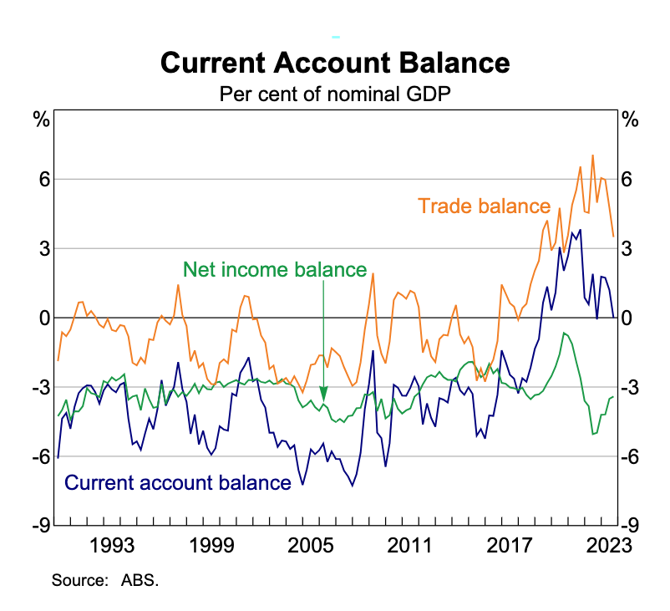

Slide 88
SUMMARISE THE RECENT TRENDS IN AUS’ CURRENT ACCOUNT BALANCE
https://www.rba.gov.au/education/resources/explainers/trends-in-australias-balance-of-payments.html
In your notebook,
Identify the trends in Aus’ CAB for the past 10 years
Outline the reasons for the trends in our trade balance / BOGS

Slide 89

FACTORS INFLUENCING THE INCOME BALANCE
SYLLABUS:
the reasons for Australia’s current account balance in terms of the factors influencing the income balance
the current account balance and savings/investment gap

Slide 90
AUSTRALIA’S BOP AN OVERVIEW
BOGS – Mostly negative
NPY - Always deficit
CAB – 44 years of CAD (Current Account Deficit), changed to a CAS (Current Account Surplus) in 2019, back to CAD Sept 2023
KAFA - Surplus of 44 years, changed to a deficit in 2019, back to surplus Sept 2023
Notes:
CAS – huge increase in export earnings, import growth slowed (during covid), NPY remained negative but trade surplus was so large it outweighed NPY effects
2019 – record high iron prices due to supply shock (collapse at a major brazillion mine site), strong LNG exports, domestic economy was sluggish so import growth slowed, lower NPY as global interest rates were low and falling therefore reduced interest repayments on Aus Foreign debt

Slide 91
NPY = SERVICING COSTS
NPY = Net primary income
Australia’s NPY deficit reflects Australia’s net servicing costs owed overseas
Servicing costs on foreign debt (borrowing from overseas) = interest payments on loans
Servicing costs on foreign equity (foreign investment into Australia) = dividend payments and profits
Servicing costs: future financial obligations for borrowing funds (interest) or attracting foreign investment (dividends/ profits)
Notes:
NPY - While Australia has been exporting more goods and services than it imports since September 2019, money has flowed out of Australia in exchange for increased ownership of foreign assets, including Australian superannuation funds' purchasing of overseas equities.
This is due to Australia relying heavily on foreign investment to fund economic growth

Slide 92
SAVINGS-INVESTMENT GAP
The main reason for the NPY deficit in Australia is due to the savings investment gap (S-I gap):
Australia has a small population and a relatively low national savings rate
This creates a gap between out intended investment levels and the amount of domestic savings
To solve this Australia:
Borrows from overseas (foreign debt)
Sells ownership of Australian assets (foreign equity)
Both steps create future servicing obligations in the form of interest repayments (on debt) and dividends (on equity)
This increases NPY outflows, increases the NPY deficit and decreases the CAB

Slide 93
Describe what would happen to the CAD if Australia increased its national savings level
Current situation: low national savings creates S-I gap
S-I gap creates need for foreign borrowing and equity
This creates outflows of NPY, therefore decreasing the CAB
What would higher national savings mean?
Lower S-I gap
Firms could fund projects from domestic savings instead of foreign capital
Less need for foreign borrowing and equity required
Fewer outflows of NPY (to pay interest/ dividends/ profit), lower NPY deficit, increases the CAB (shrinking the CAD)

Slide 94
HOW DOES NPY INFLUENCE THE CAB?
Value of the AUD:
The value of the AUD will affect the value of foreign debt in AUD terms
For example: a stronger AUD will decrease the value of FD (in foreign currency terms)
This will reduce the value of NPY debits (interest payments) and reduce the NPY deficit and increase the CAB
This is the valuation effect – where changes in the value of the AUD will alter the value of the foreign debt in foreign currency terms
Changes in the domestic business cycle:
In Australia, approximately 40 per cent of the share market is foreign owned
If the Australian economy improves and companies record higher profits, they will have to then pay higher dividends to all shareholders, including OS SH
Higher domestic company profits means higher dividend outflows, which increases NPY deficit and decreases the CAB
Changes in domestic and global interest rates
The servicing costs (interest payments) are set by an interest rate – either an OS IR or the AIR
If global interest rates reduce, this will decrease the value of interest payments required on Australia’s foreign debt, in turn, this will shrink NPY outflow, decrease the NPY deficit and increase the CAB

Slide 95
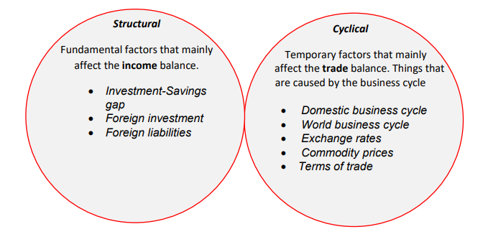
Summary of factors affecting CAB

Slide 96
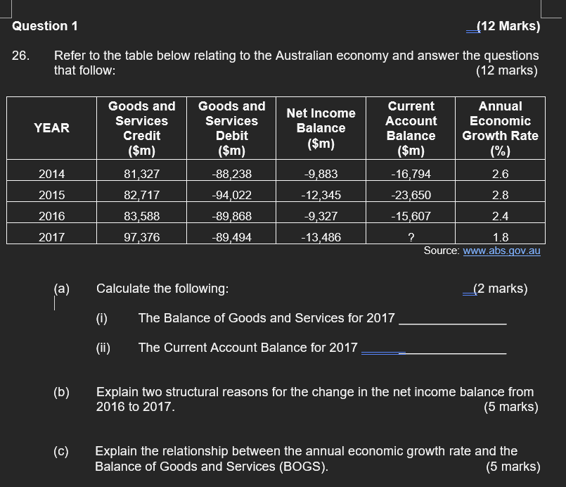
Independent Practice

Slide 97

TRENDS IN THE CAB AND KAFA
SYLLABUS:
trends in Australia’s current account and financial account over the last ten years

Slide 98
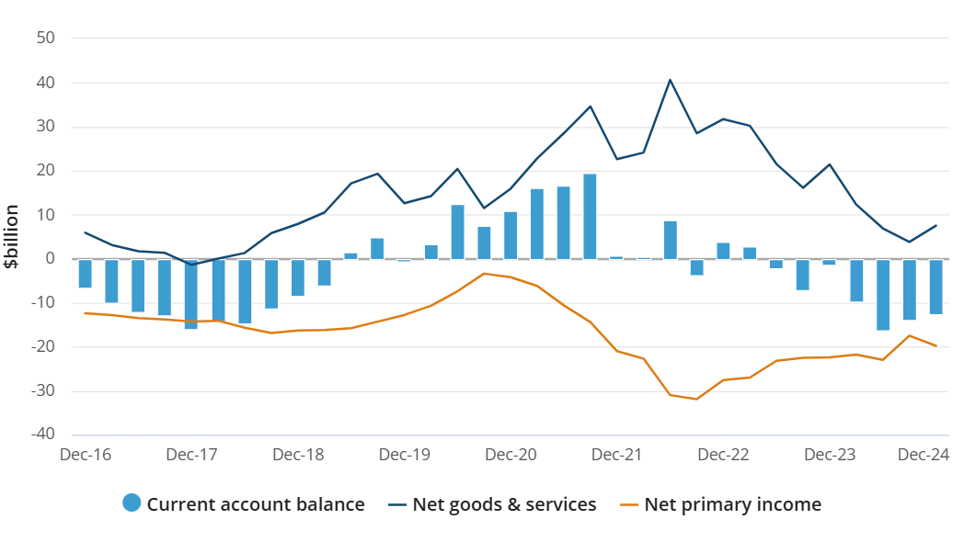
TRENDS AUSTRALIA’S CAB OVER THE PAST 10 YEARS

Slide 99
TRENDS IN AUSTRALIA’S CAB OVER THE LAST 10 YEARS
Overall, CAB fluctuated from deficit of -$6.6 billion in Dec 2016 to -$12.2 billion in Dec 2024.
BOGS/Trade Balance fluctuated yearly, Went into deficit in Dec 17 (-$1.4 billion) reaching a peak of $40.6 billion in Jun 22 before dropping to $7.5 billion in Dec 24
NPY always in deficit due to net inflow of FI into our economy = debit payments to our foreign investors (dividends & interests)
Most of the time CAB is in deficit (dec 16, 17, 18, 19, 23, 14), 2020 – Mar 2023 exception
Often NPY deficit > BOGS surplus → CAD
Source: ABS

Slide 100
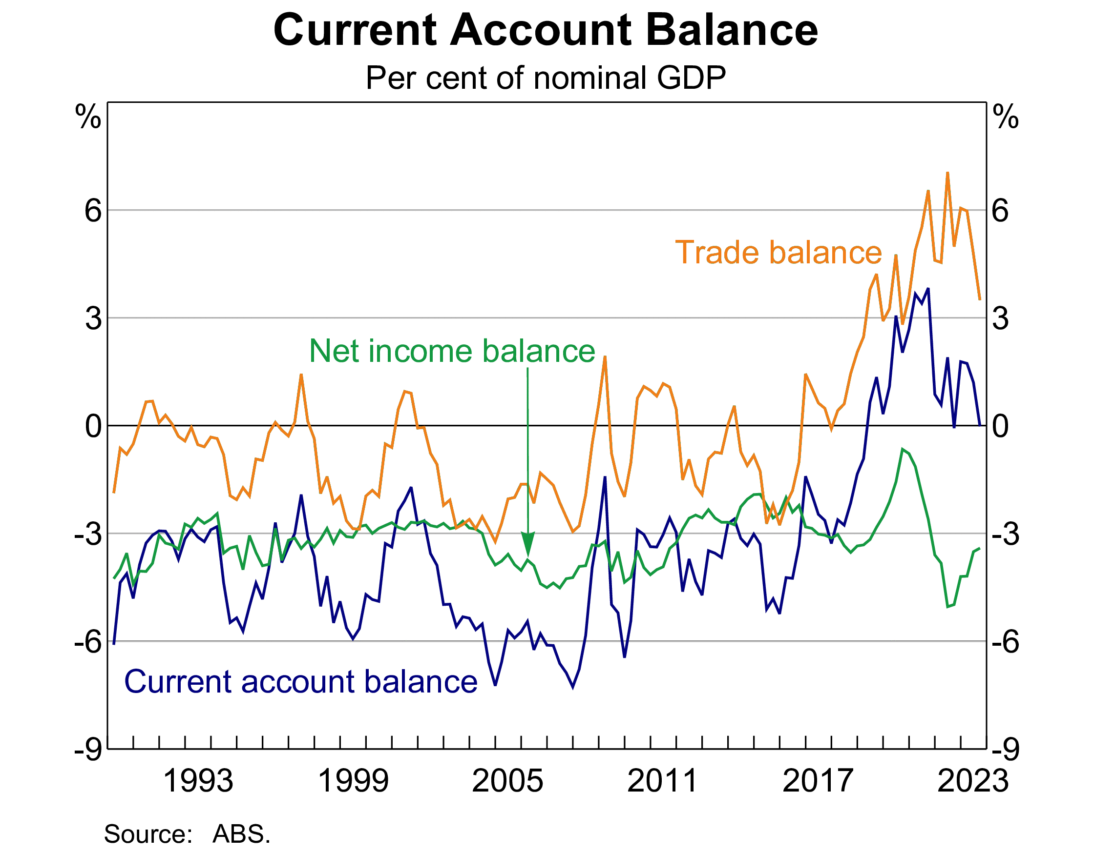
2015-2016: FALLING CAB
Trade Balance FALLING
TOT falling (M prices > X prices)
Overseas growth declining
Weaker commodity prices
NET Y deficit STABLE SLIGHT FALL
Reduced profitability of Aust firms
Lower Global IR = more investment into Aust
OVERALL - Fall in CA due to fall in trade balance despite slight fall in Net Y Deficit. CAD.

Slide 101
2017-2018: RISING CAB
Trade Balance RISING
Rising X prices (increasing commodity prices)
Rising Service and Mining X volumes (particularly LNG) due to strong overseas demand
Trade surplus (X > M)
Net Y deficit RISING
Rising profitability of Aust firms which are primarily foreign owned
Non mining I rising
Global IR rising
OVERALL - Rise in CA. Caused by sharp rise in trade surplus despite rise in Net Y deficit. However, CAD.

Slide 102
MID 2019 – MAR 2023: RISING CAB
As of June 2019 – Mar 2023, Australia has maintained a current account surplus. This had not been achieved since 1975 – 44 years.
Trade Balance RISING
Rising X prices (increasing commodity prices)
Rising Service and Mining X volumes due to
Strong overseas demand
Trade surplus (X > M)
Weaker domestic consumption due to recession in 2020 = decr. M
Travel restrictions between 2020-2021 = surplus in services due to outbound tourism (services are usually in deficit)
Net Y Deficit FALLING
Covid cautiousness= Falling FI (thus less repayments) and increased savings
Falling profitability of Australian firms
In 2020, income deficit decreasing in size
In late 2021 – 2022, Aus economy has done well and FI continued to flow in → NPY deficit increasing
OVERALL - Rise in CA. Caused by sharp rise in trade surplus and initially decrease in NPY deficit. Even as NPY deficit increases post 2021, strong trade surplus → CAS
Notes:
CAS – huge increase in export earnings, import growth slowed (during covid), NPY remained negative but trade surplus was so large it outweighed NPY effects
2019 – record high iron prices due to supply shock (collapse at a major brazillion mine site), strong LNG exports, domestic economy was sluggish so import growth slowed, lower NPY as global interest rates were low and falling therefore reduced interest repayments on Aus Foreign debt

Slide 103
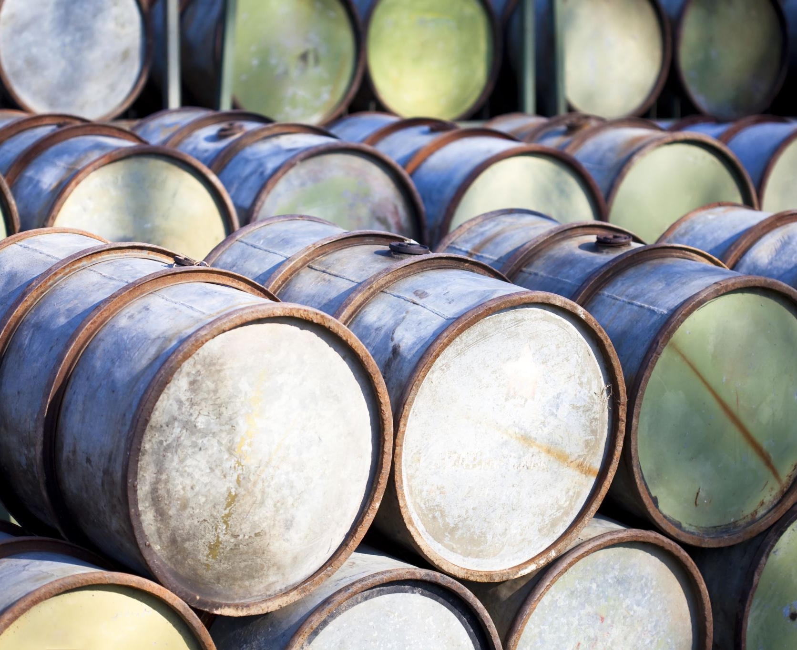
WHY DID AUSTRALIA HAVE A CAS 2019-2023?
Surplus starts in March 2019
NPY is still in deficit – income deficit has shrunk but is still a deficit, so NPY is not the reason (fully) for the CAS
BOGS is in surplus – 30bn June 2021
BOGS has increased overall
Came off the back of strong bulk commodity prices – in particular, iron ore price drove a record metal ores and mineral export value of $53.3bn.
Imports continued to rise, driven by increases in fuel imports coinciding with the opening of the Trans-Tasman travel bubble.
Government stimulus policies and the easing of freight backlogs resulted in increased imports for transport equipment and machinery across consumption and capital goods.
Notes:
CAS – huge increase in export earnings, import growth slowed (during covid), NPY remained negative but trade surplus was so large it outweighed NPY effects
2019 – record high iron prices due to supply shock (collapse at a major brazillion mine site), strong LNG exports, domestic economy was sluggish so import growth slowed, lower NPY as global interest rates were low and falling therefore reduced interest repayments on Aus Foreign debt

Slide 104
Post Pandemic return to normal 2023-2025
Economy recovered strongly
Increase in income → increase in M
Additionally, commodity prices start to fall → Trade Balance / BOGS (start to fall)
Increase in investor confidence & higher profits → increase in FI → Increase in dividends and interest paid (deficit in NPY)
Returned to CAD by 2024

Slide 105
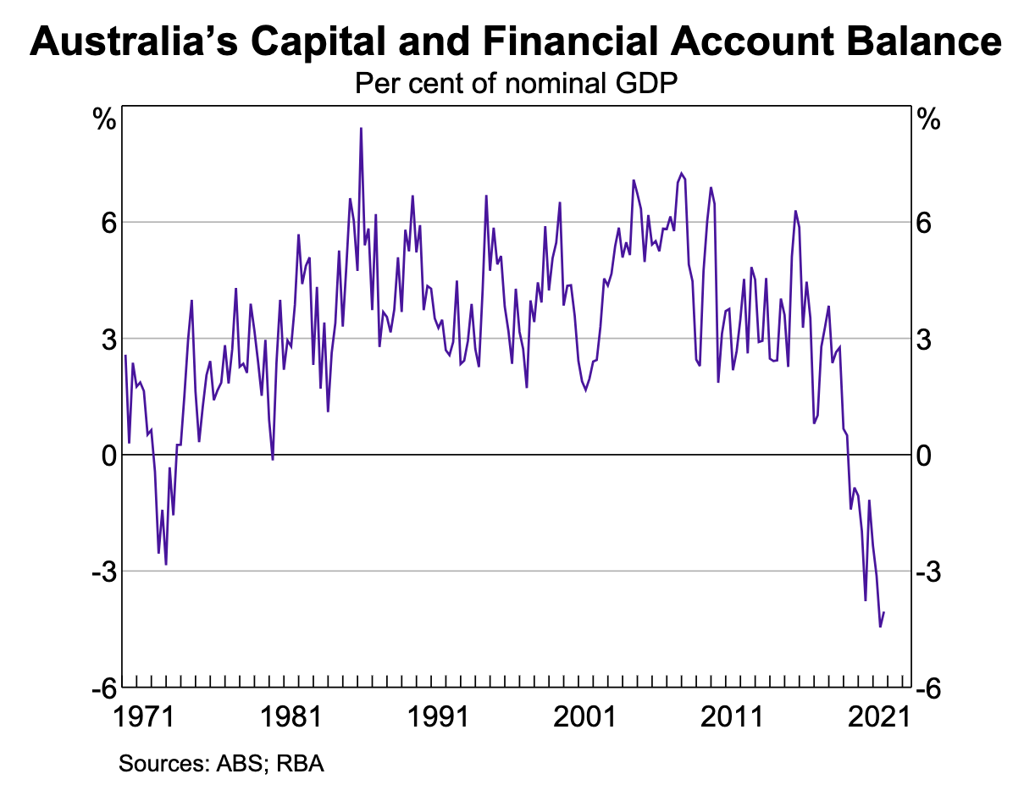

Slide 106
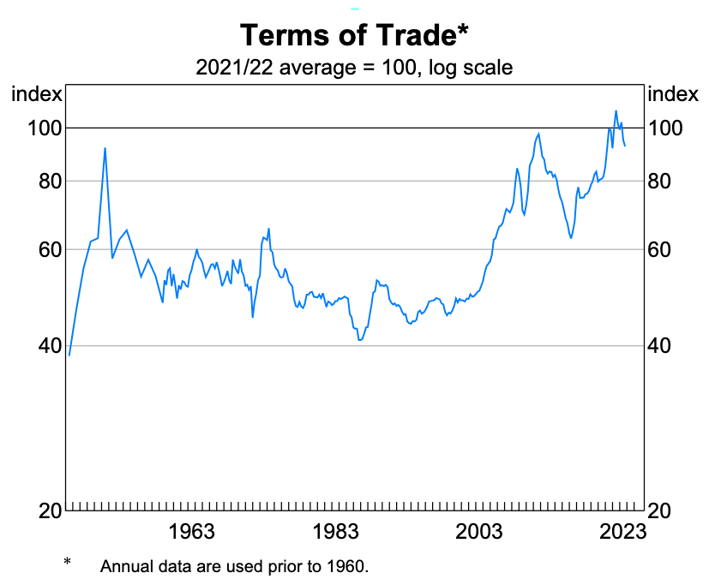
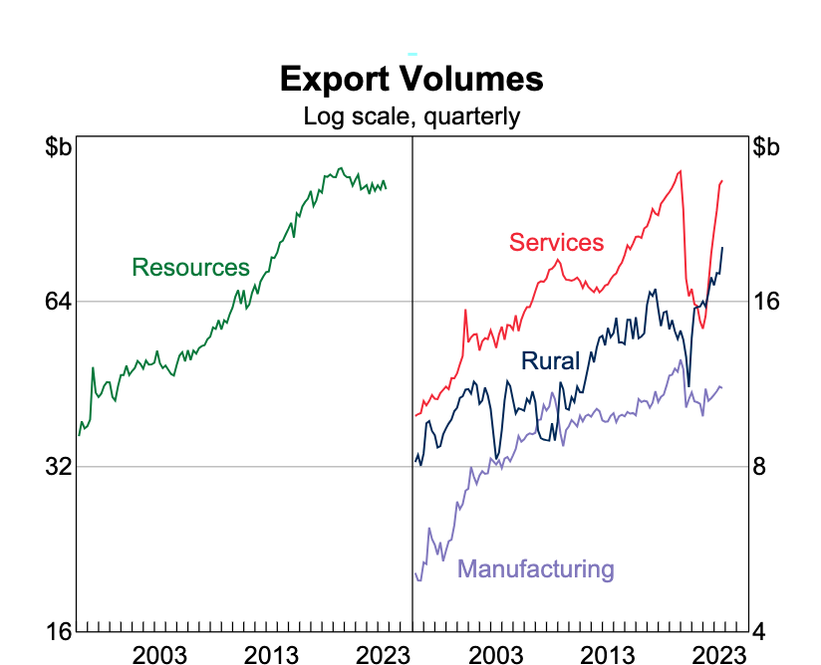
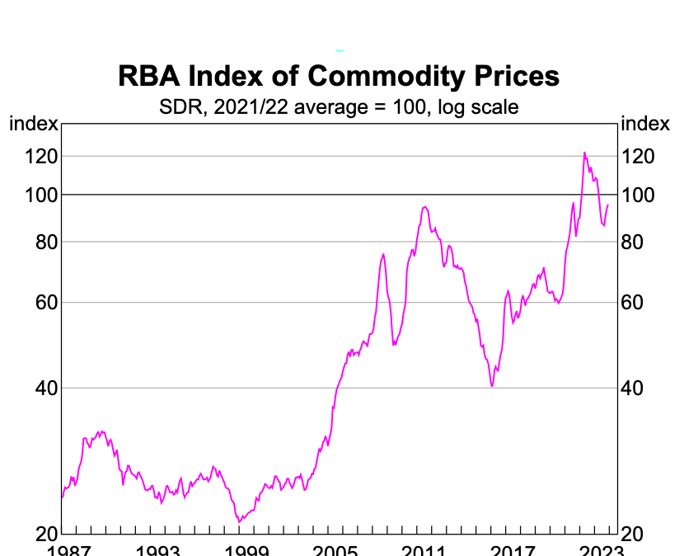
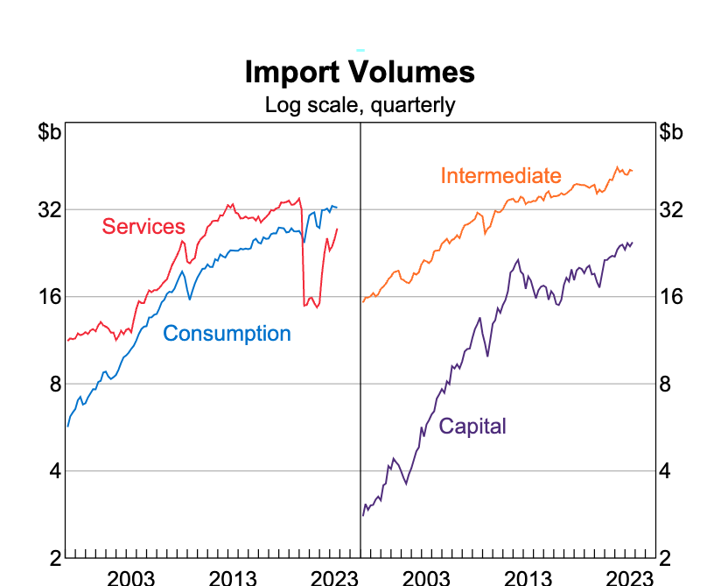
Other charts to track trends in BOGS

Slide 107
TRENDS IN AUSTRALIA’S KAFA OVER THE LAST 10 YEARS

Slide 108
TRENDS IN THE KAFA
Historically, the Australian economy has generally been a net recipient of capital inflows from the rest of the world.
The savings of the domestic economy have been supplemented with inflows of capital from abroad to fund the relatively high level of investment in the Australian economy.
This has been reflected in a capital and financial account surplus – the counterpart to Australia's current account deficits.
In recent years, there has been a net outflow of capital from Australia – that is, Australians have invested more overseas than those abroad have invested in Australia's economy.
This has been reflected in a capital and financial account deficit and is consistent with the recent shift to a current account surplus.

Slide 109
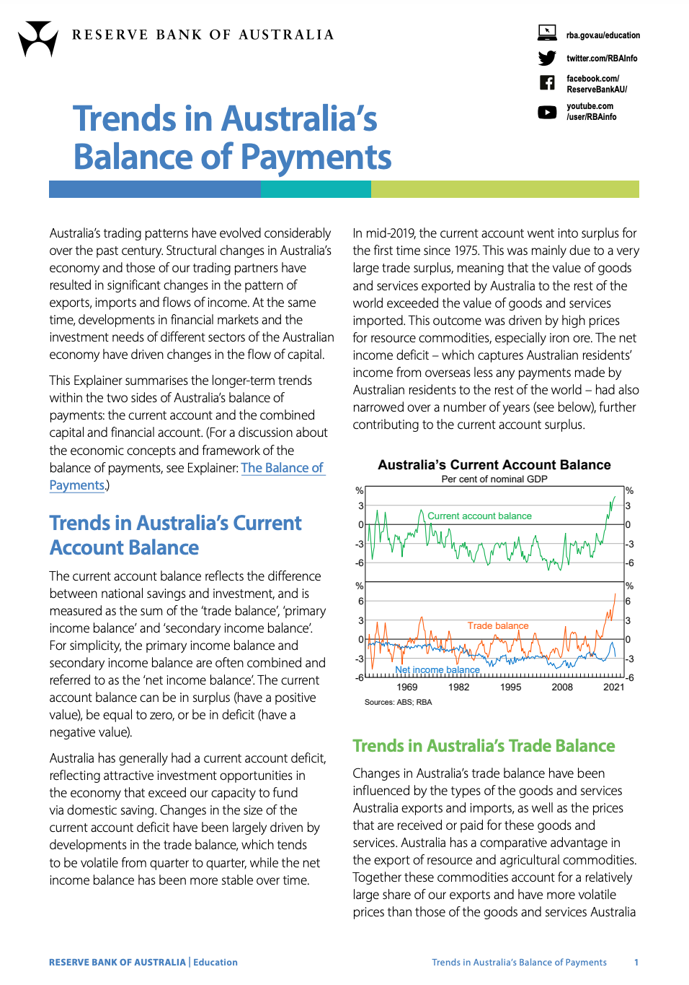
Independent Practice
Read through the RBA explainer ‘Trends in Australia’s Balance of Payments’
Add to your notes on the trends in the Capital and Financial Account (KAFA)

Slide 110

HELPFUL LINKS FOR ADDITIONAL INFORMATION
https://www.miragenews.com/australias-current-account-surplus-drops-due-to-1077624/
https://www.abs.gov.au/statistics/economy/international-trade/balance-payments-and-international-investment-position-australia/latest-release#data-downloads

